Slide 1
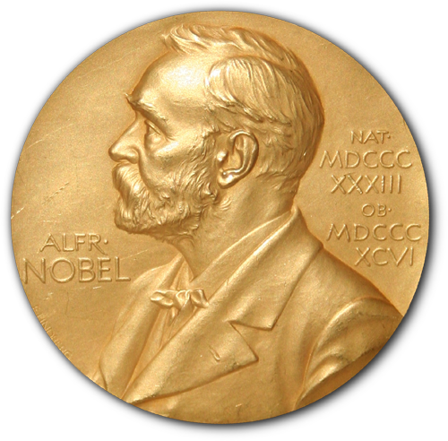
Visualization of Nobel Awards Data
Keyur Kirti Mehta
Sundaram Narasimhan. C

Slide 2
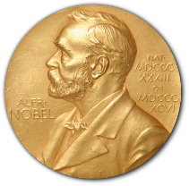
Contents
Introduction
Motivation
Dataset, Technologies
List of Visualizations
Screenshots

Slide 3
Introduction
One of the most prestigious awards
Initiated by Alfred Nobel by a will
Established in 1895
First award given in 1901
Awards given in different categories in recognition of academic, cultural or scientific contributions.
Till date 579 awards given to 911 people and organisations.

Slide 4
Motivation
No consolidated place for visualization of the data
Many parameters in data set allowing possibility to compare and analyse
Clear visualization of noble prize winners.

Slide 5
Dataset
Dataset comprising more than 900 records
Dataset comprises 9 attributes
Technologies Used
D3.js(version 4)
Topojson(version 1)
HTML, CSS
JavaScript

Slide 6
Visualizations
Geo Visualization
Bar Chart
Bubble Chart
Trend Chart
Pie Chart

Slide 7
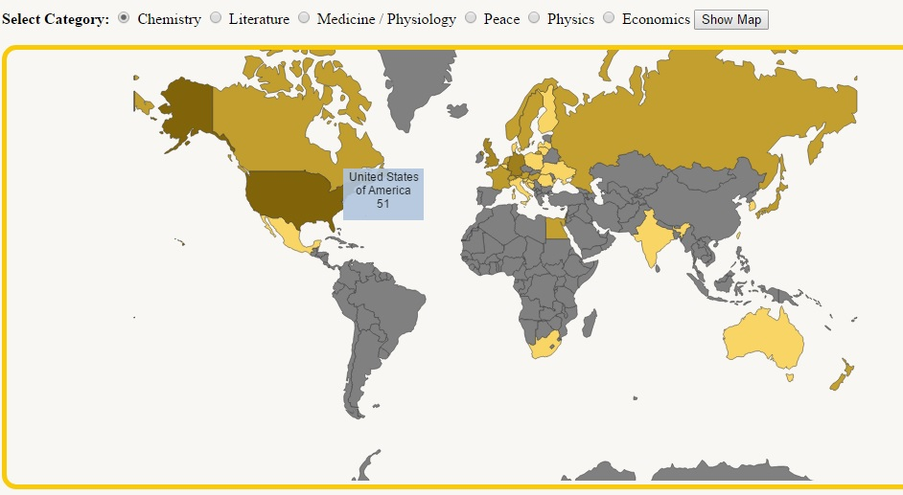
Geo Visualization

Slide 8
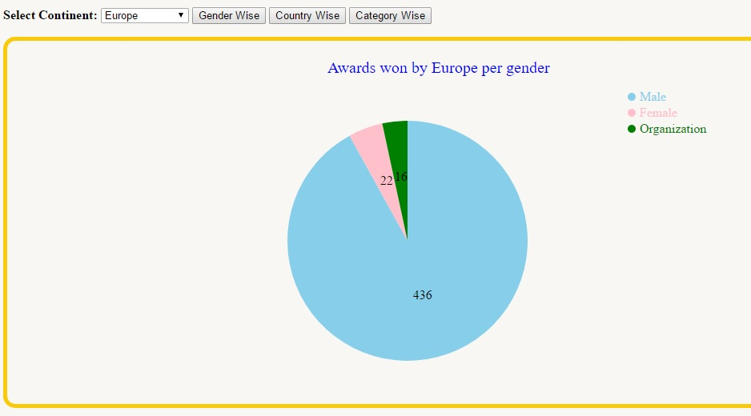
Gender Wise Visualization

Slide 9
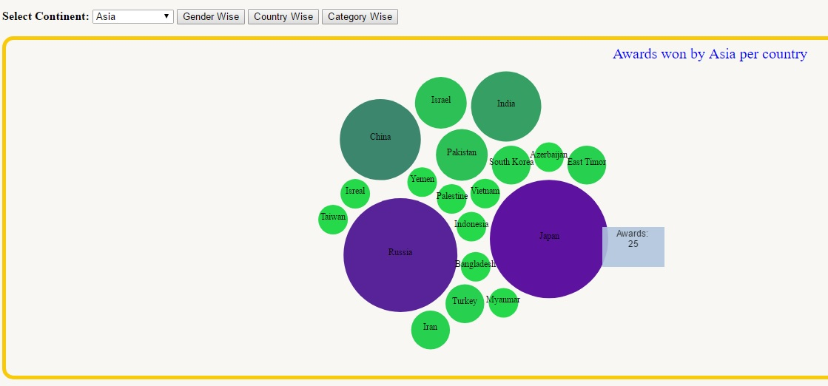
Country Wise Visualization

Slide 10
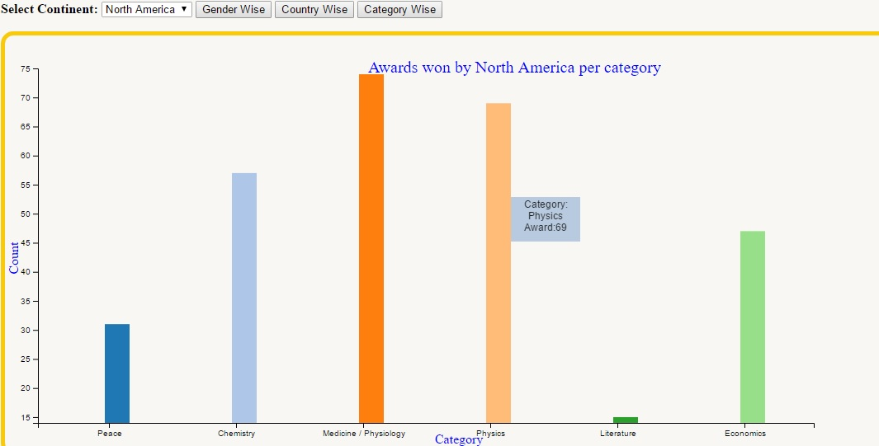
Category Wise Visualization

Slide 11
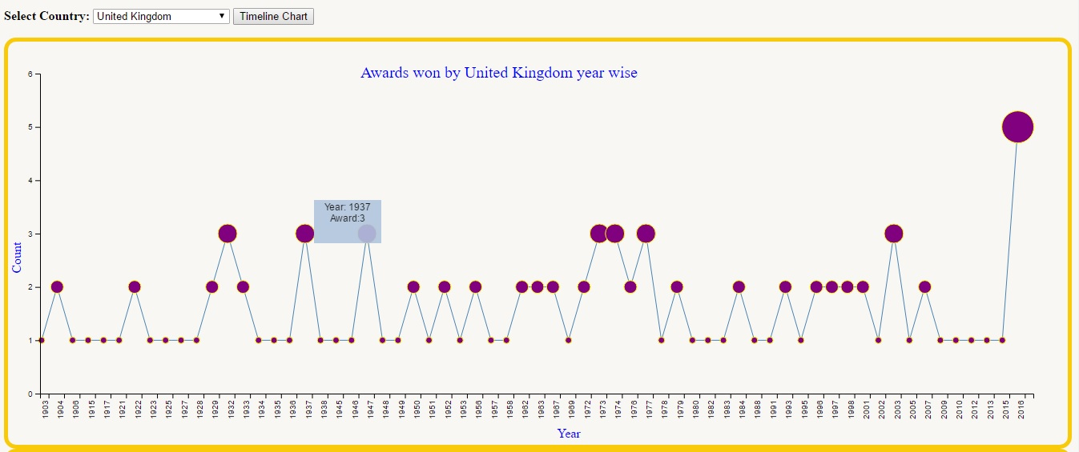
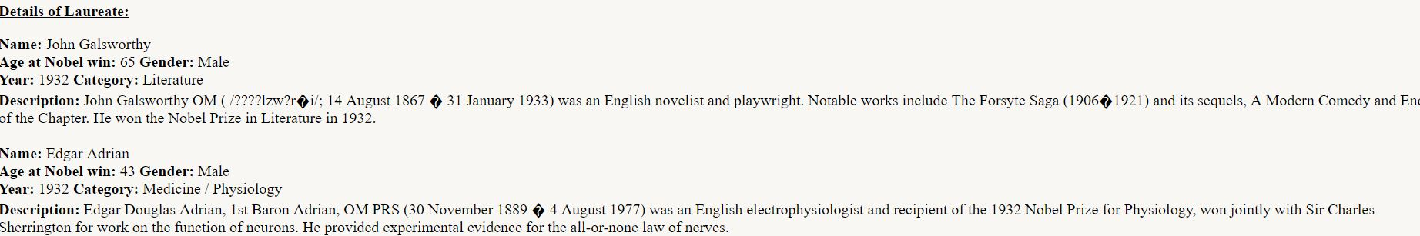
Timeline Visualization

Slide 12
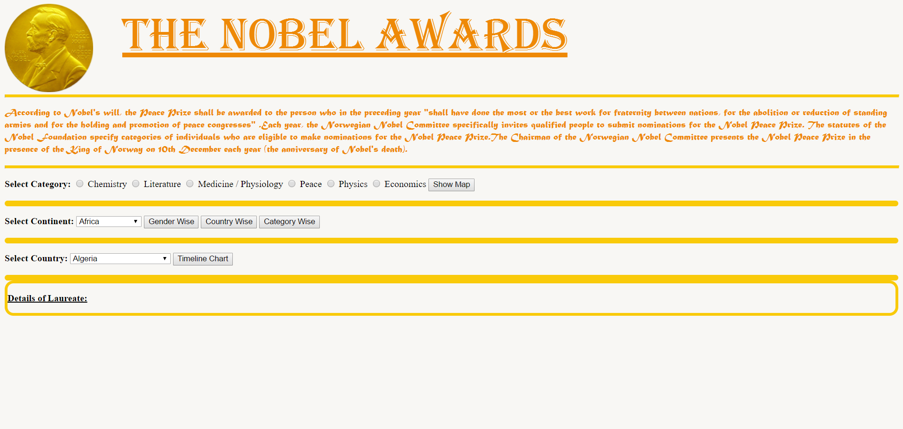
Lets move to demo!!!

Slide 13
Thank You!

